Slide 1


Department of Computer Engineering
Branch : Computer Science and Design
Subject : Programming in Java
Subject Code : 202044502
Seminar
Title : Automated Billing Management System
Prepared By : ( 1 ) Jigar Chavda ( En.No. : 12302130501027 )
Guided By : Prof. Kuratulain Kaji

Slide 2

Key Points
Objective
Key Features
Class : Product – Attributes and Methods
Core Class Overview
Class : BillingSystem - Attributes
Text Files
Workflow
Bill Generation Process
Class Diagram
Exception Handling
Class : BillingSystem - Methods
Output & Features

Slide 3
Objective
To create a simple and efficient CLI based billing management system in Java.
Provide admin login inventory management and automated bill generation with tax and discount calculations

Slide 4
Key Features
Admin Login Authentication
Load Product Inventory from text file
Add, Edit and Delete Products
View Product Inventory
Generate Bills with gst 80 % and discount 5 %
Save bill as text files
Open Bill in notepad automatically

Slide 5
Text Files
login.txt file which contains username and password
login.txt matches the entered username and password in output of BillingSystem.java
products.txt file which contains product ID,Name,Price,Stock Quantity
products.txt file gives List of available products in output of BillingSystem.java
Bill_name_date_time.txt file is created after Bill Generation Process

Slide 6
Core Class Overview
Product Class :
Manages individual product details such as ID, Name, Price, and Quantity.
Used to represent each product in the inventory.
BillingSystem Class :
Acts as the main controller for the entire system.
Handles :
Admin Login Authentication
Product Inventory Management (Add, Edit, Delete, View)
Bill Generation Process with GST and Discount
File Operations (loading credentials, products, saving bills)
Input Validations and Exception Handling

Slide 7
Class : Product – Attributes and Methods
Attributes :
Attribute | Data Type | Description
id | int | Unique Product ID
name | String | Name of the Product
price | double | Price per unit of the Product
quantity | int | Available stock quentity
Methods :
Constructor : Product(int id, String name, double price, int quantity
Initializes a product object with it’s ID, name, price, and quantity.

Slide 8
Class : BillingSystem - Attributes
Attributes :
Attribute | Data Type | Description
Inventory | List<Product> | List to store all available product records
credentials | Map<String, String> | Stores admin usernames and passwords for login authentication

Slide 9
Class : BillingSystem - Methods
Login & File Operations :
loadCredentials() : Loads login data from file.
login() : Authenticates admin.
loadProductsFromFile() : Loads product data from file.
Product Management :
addProduct(Scanner) : Add new product.
editProduct(Scanner) : Edit existing product details.
deleteProduct(Scanner) : Remove product by ID.
viewAllProducts() : Display current product inventory.
Billing Process :
generateBill(Scanner) : Manage billing process :
Add product to bill
Check stock
Calculate subtotal
Add GST (18%)
Apply Discount (5%)
Save bill as text file
Open bill in Notepad
Main Program :
main(String[] args) : System’s entry point with CLI menu.

Slide 10
Exception Handling
Login Validation :
If entered username or password is incorrect, system displays :
Invalid credentials. Access Denied.
Product ID Validation ( While Billing ) :
If entered product ID is not in inventory :
Product not found!
Product Quantity Validation ( While Billing ) :
If entered quantity exceeds available stock :
Not enough stock available! Re-enter quantity.
File Operation Exception Handling :
For reading/writing files using try-catch blocks for IOException.
Catch (IOException e) {
System.out.println(“Error writing bill to file.”);
}

Slide 11
Workflow
Admin Login
Load Inventory
Manage Products (Add/Edit/Delete/View)
Generate Customer Bill
Calculate GST & Discount
Save and Display Bill

Slide 12
Bill Generation Process
Enter Customer Name
Select Products by ID
Enter Quantity
Validate Stock Availability
Calculate Subtotal, GST, Discount
Save Bill File
Open Bill in Notepad

Slide 13
Class Diagram
class BillingSystem
Inventory : List<Product> Credentials : Map<String, String>
Methods
loadCredentials() Login() loadProductsFromFile() addProducts(Scanner) editProducts(Scanner) deleteProducts(Scanner) viewAllProducts() generateBill(Scanner) Main(String[] args)
class product
id : int name : string price : double Quantity : int
Methods
Product(id,name,price,quantity)
Handles validations & exceptions
Validation & Exception Handling
Invalid login Invalid Product ID Insufficient Stock File I/O Errors (IO Exception)
uses List<products>

Slide 14
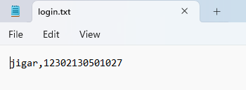
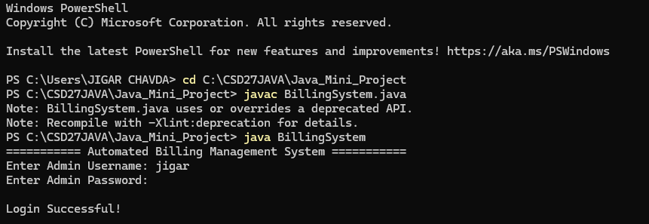
Output
Asks for User Authentication via Username and Password.
The entered Username and Password should match with login.txt file for Successful Login otherwise it will be failed to Login.

Slide 15
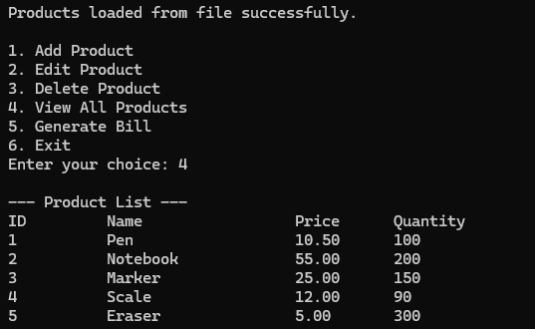
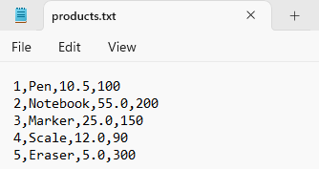
Output
After Login, This Main Menu Pops in First.
We can Press 4 to View available Products.
The available Products is the products.txt file’s data.

Slide 16
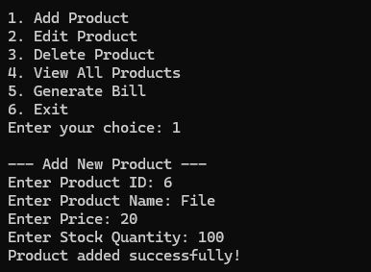
Output
We can Press 1 to Add new Products in available Products List.
It asks for new product’s ID, Name, Price and Stock Quantity.
Then show message “Product Added Successfully! “

Slide 17
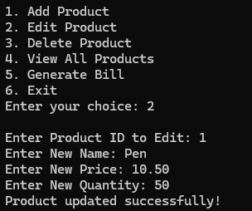
Output
We can Press 2 to edit available Product’s details in available Products List.
It asks for available product’s new ID, Name, Price and Stock Quantity.
Then show message “Product Updated Successfully! “

Slide 18
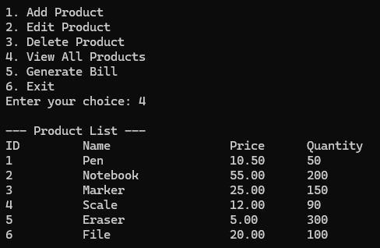
Output
This is the output after Adding and Upadte product details.
We can show the new product at ID : 6 with Name : File, Price : 20.00 and Quantity : 100
We can show the Product ID 1’s Quantity detail is changed from 100 to 50

Slide 19
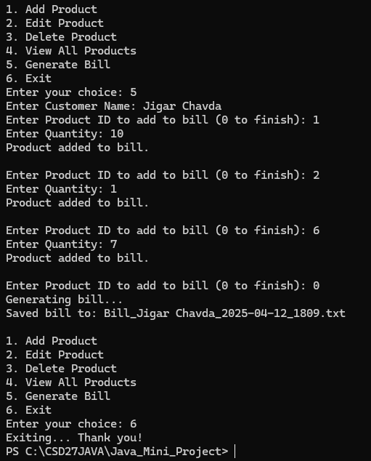
Output
We can Press 5 to Generate Bills.
First it asks for Customer Name
We can add Product ID and Quantity that customer purchased.
Then it will show “Product added Successfully” message.
If Product ID isn’t available in available products list or Quantity entered is more than available then it will again asks for enter valid Product ID or Quantity respectively.
After Pressing 0 the Bill Generating process completed and show message “Generating Bill”.

Slide 20
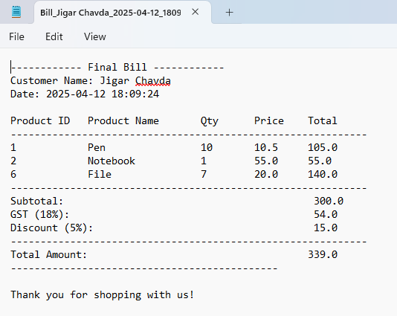
Output
When the Bill Generating message shown after that another message shown “Saved Bill to : Bill_name_date_time.txt”
When this message shown then automatically a Bill_name_date_time.txt file open.
We can again Press 5 to generate another bills or Press 6 to Exit Automated Billing Management System.

Slide 21
Features
Current Features :
Admin Authentication
CLI-based Inventory Management
Automated Billing with GST and Discount
Bill File Saving and Openinglogin() : Authenticates admin.
Potential Enhancements :
Database Integration for Inventory
GUI-based System (JavaFX / Swing)
User Role Management (Cashier/Admin)
Real-time Inventory Update
Product Search by Name or ID

Slide 22
THANK YOU !!

